Slide 1
PN Junction – Diode Characteristics
Unit 2 Section 1
PEE
FE CSBS
2019-2020

Slide 2
Revision-Drift and Diffusion Currents
Current
Generated by the movement of charged particles
(negatively charged electrons and positively charged holes).
Carriers
  The charged electrons and holes are referred to as carriers
The two basic processes which cause electrons and holes move in a semiconductor:
  Drift - the movement caused by electric field.
  Diffusion - the flow caused by variations in the concentration.

Slide 3
Drift Currents
Drift Current Density (n-type semiconductor)
  An electric field E applied to n-type semiconductor with a large number of free electrons.
    Produces a force on the electrons in the opposite direction, because of the electrons’ negative charge.
    The electrons acquire a drift velocity, V_{dn} (in cm/s):
N-type
E
Vdn
e
I

Slide 4
Drift Currents
Drift Current Density (p-type semiconductor)
  An electric field E applied to p-type semiconductor with a large number of holes.
    Produces a force on the holes in the same direction, because of the positive charge on the holes.
    The holes acquire a drift velocity, V_{dp}(in cm/s):
P-type
E
p
Vdp
I

Slide 5
Diffusion Current
The basic diffusion process
  Flow of particles from a region of high-concentration to a region of low-concentration.
  The movement of the particles will then generate the diffusion current

Slide 6
The pn Junction

Slide 7
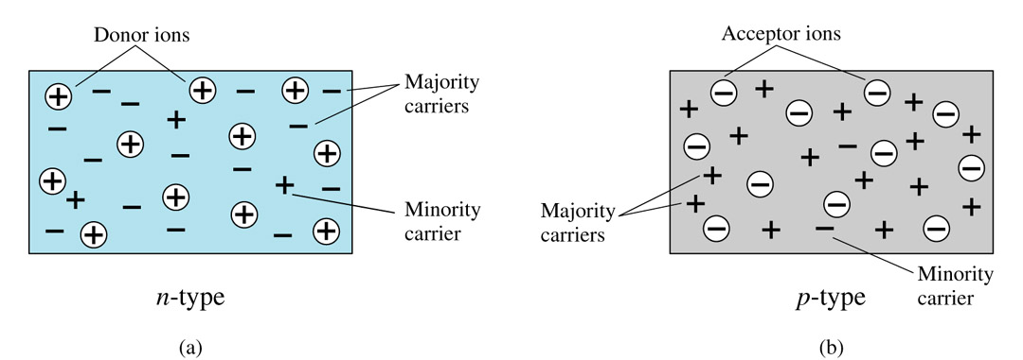
n-type versus p-type
In n-type - the electrons are the majority carriers and holes are the minority carriers.
In p-type - the holes are called the majority carriers and electrons are the minority carriers.

Slide 8
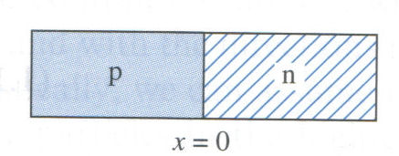
The Equilibrium pn Junction
Join n-type and p-type doped Silicon (or Germanium) to form a p-n junction.
Creates a charge separation that sets up electric field, E
Electron diffusion
Hole diffusion
- -
- -
- -
++
++
++
p
n
E
The Electric field will create a force that will stop the diffusion of carriers → reaches thermal equilibrium condition

Slide 9
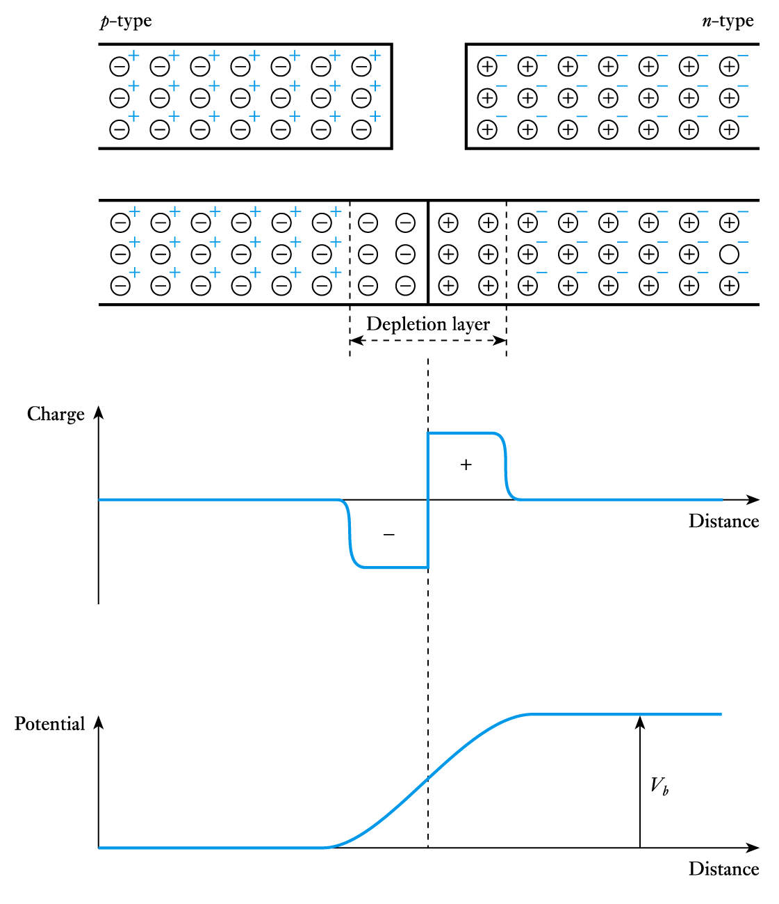
The diffusion of positive charge in one direction and negative charge in the other produces a charge imbalance
  this results in a potential barrier across the junction

Slide 10
Potential barrier
  the barrier opposes the flow of majority charge carriers and only a small number have enough energy to surmount it
    this generates a small diffusion current
  the barrier encourages the flow of minority carriers and any that come close to it will be swept over
    this generates a small drift current
  for an isolated junction these two currents must balance each other and the net current is zero

Slide 11
E_{vac}
E_{vac}
p-Si
n-Si
e×φ_{n-Si}
e×φ_{p-Si}
E_{F}
E_{F}

Slide 12
E_{vac}
E_{vac}
p-Si
n-Si
e×φ_{n-Si}
e×φ_{p-Si}
E_{F}
E_{F}

Slide 13

Depleted region on both sides
E_{vac}
E_{vac}
p-Si
e×φ_{p-Si}
n-Si
e×φ_{n-Si}
E_{c}
E_{c}
E_{F}
E_{F}
E_{v}
E_{v}

Slide 14
Diffusion and drift can occur at the same time.
A charge packet
E
Both also always occur across junctions

Slide 15
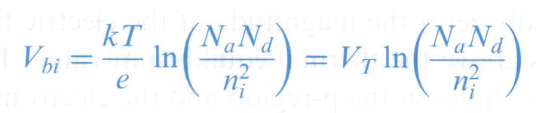
W
- -
- -
- -
++
++
++
p
E
n
Known as space charge region/depletion region.
Potential difference across the depletion region is called the built-in potential barrier, or built-in voltage:
V_{T} = kT/e
    k = Boltzmann’s constant
    T = absolute temperature
    e = the magnitude of the electronic charge = 1 eV
    N_{a} = the net acceptor concentration in the p-region
    N_{d} = the net donor concentration in the n-region
  V_{T} = thermal voltage, [V_{T} = kT / e] it is approximately 0.026 V at temp, T = 300 K

Slide 16
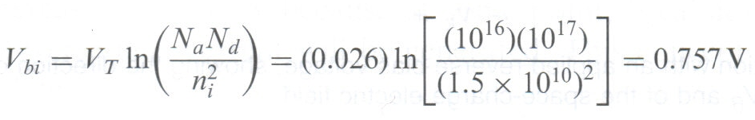
The Equilibrium pn Junction
Example 1
Calculate the built-in potential barrier of a pn junction.
Consider a silicon pn junction at T = 300 K, doped
N_{a} = 10¹⁶ cm⁻³ in the p-region, N_{d} = 10¹⁷ cm⁻³ in the
n-region and n_{i} = 1.5 x 10¹⁰ cm⁻³.
Solution

Slide 17
Example 2
Consider a silicon pn junction at T = 400K, doped with concentrations of N_{d} = 10¹⁸ cm⁻³ in n-region and N_{a} = 10¹⁹ cm⁻³ in p-region. Calculate the built-in voltage V_{bi} of the pn junction, given Given B and Eg for silicon are 5.23 x 10¹⁵ cm⁻³ K^{-3/2} and 1.1 eV respectively

Slide 18
ANSWER
Calculation of V_{T} = kT / e = 86 x 10⁻⁶ ( 400 ) / 1eV = 0.0344 V
Calculation of n_{i} = BT^{3/2} exp ( -Eg / 2kT )
= 5.23 x 10¹⁵ ( 400 ) ^{3/2} exp -1.1 / 2 (86 x 10⁻⁶ ) (400)
= 4.76 x 10¹² cm ^{–3}
Calculation of V_{bi} = V_{T} ln ( N_{a}N_{d} / n_{i} ² )
= 0.0344 ln 10¹⁸ (10¹⁹ ) / (4.76 x 10¹²)²
= 0.922V

Slide 19
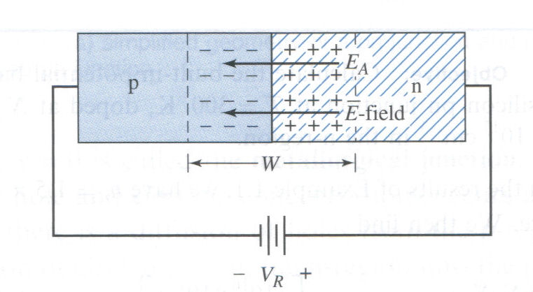
Reverse-Biased pn Junction
+ve terminal is applied to the n-region of the pn junction and vice versa.
Applied voltage V_{R} will induce an applied electric field E_{A}.
Direction of the E_{A} is the same as that of the E-field in the space-charge region.
Magnitude of the electric field in the space-charge region increases above the thermal equilibrium value. Total E_{T} = E + E_{A}
Increased electric field holds back the holes in the p-region and the electrons in the n-region.

Slide 20
Reverse-Biased pn Junction
Hence, no current across the pn junction.
This applied voltage polarity is called reverse bias.
E ∝ charge so, since there is an increase of the electric field in the depletion region, the number of charges increases too since the width of the depletion increases.
W
- -
- -
- -
++
++
++
p
n
Equilibrium
E
- -
- -
- -
- -
- -
- -
++
++
++
++
++
++
E_{T}
p
n
Reverse Biased
W_{R}

Slide 21
Reverse bias
  If the p-type side is made negative with respect to the
  n-type side the height of the barrier is increased
  The number of majority charge carriers that have sufficient energy to surmount it rapidly decreases
  The diffusion current therefore vanishes while the drift current remains the same
  Thus the only current is a small leakage current caused by the (approximately constant) drift current
  the leakage current is usually negligible (a few nA)

Slide 22

The space charges increase with increase of reverse-bias voltage, so a capacitor is associated with the pn junction when a reverse-bias voltage is applied. The junction capacitance or depletion layer capacitance of a pn junction is
V_{bi}
EXAMPLE 2.4 Calculate the junction capacitance of a silicon pn junction diode. Consider that the diode is at room temperature (T = 300°K), with doping concentrations of cm⁻³ , cm⁻³ and let . Calculate the junction capacitance at reverse bias 3.5 V.

Slide 23
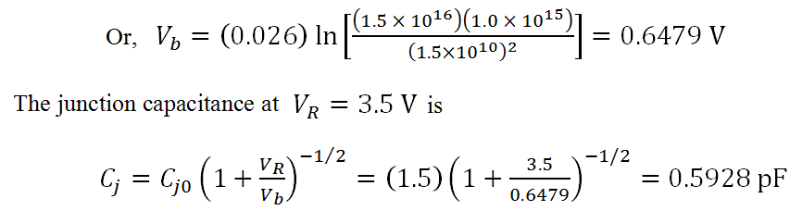

Slide 24
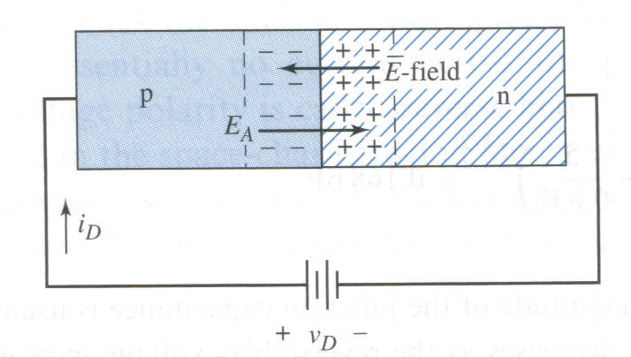
Forward-Biased pn Junction
+ve terminal is applied to the p-region of the pn junction and vice versa.
Direction of the applied electric field E_{A} is the opposite as that of the E-field in the space-charge region.
The net result is that the electric field in the space-charge region lower than the thermal equilibrium value causing diffusion of charges to begin again.
The diffusion process continues as long as V_{D} is applied.
Creating current in the pn junction, i_{D}.

Slide 25
Forward-Biased pn Junction
W
- -
- -
- -
++
++
++
p
n
Equilibrium
E
- -
- -
- -
++
++
++
p
n
Forward Biased
W_{F}
Width reduces, causing diffusion of carriers→ current flows

Slide 26
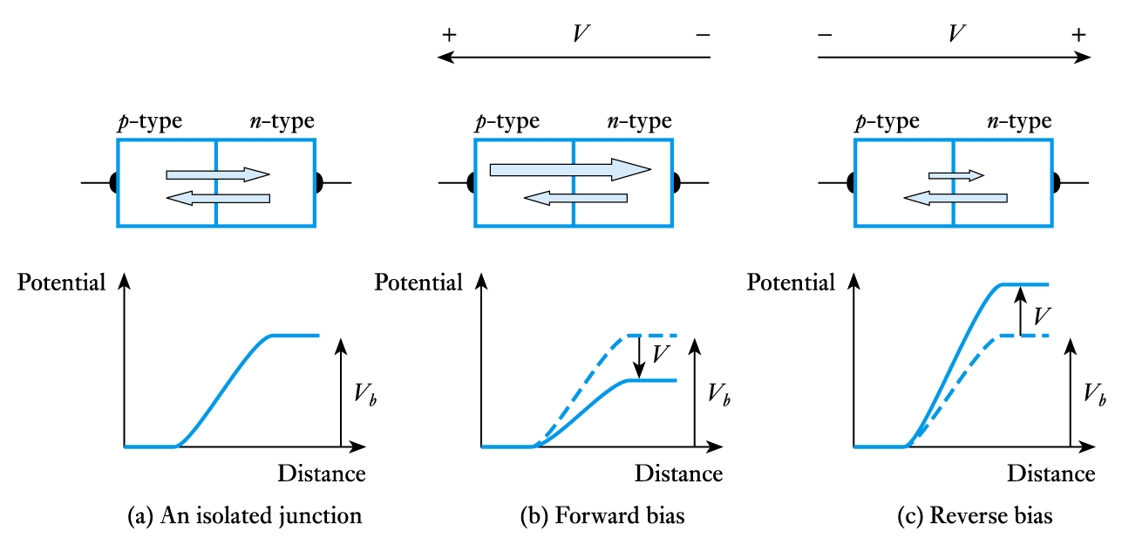
Currents in a pn junction

Slide 27
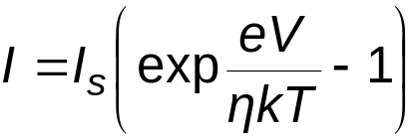
Forward and reverse currents
  pn junction current is given approximately by
  where I is the current, e is the electronic charge, V is the applied voltage, k is Boltzmann’s constant, T is the absolute temperature and η (Greek letter eta) is a constant in the range 1 to 2 determined by the junction material
  for most purposes we can assume η = 1

Slide 28
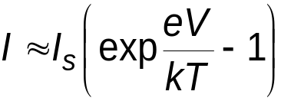
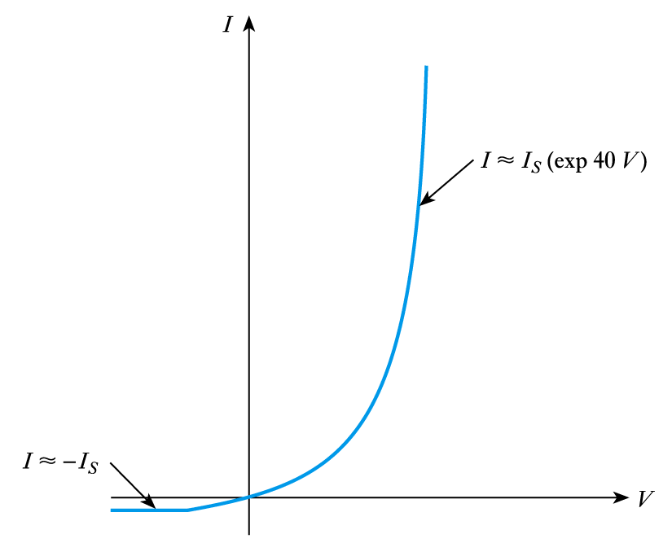
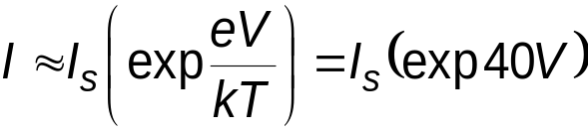

Thus
  at room temperature e/kT ~ 40 V⁻¹
If V > +0.1 V
If V < -0.1 V
  I_{S} is the reverse saturation current

Slide 29

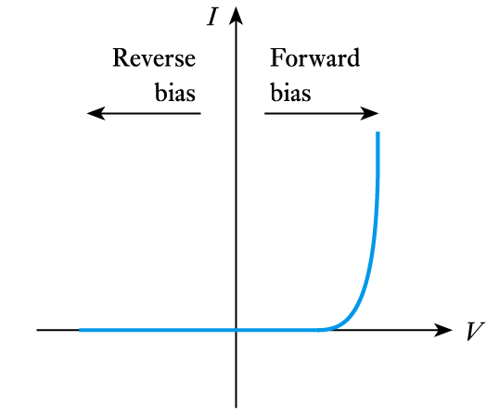
Semiconductor Diodes
19.6
Forward and reverse currents

Slide 30

Ideal Current-Voltage Relationship
So, the current i_{D} is
I_{S} = the reverse-bias saturation current (for silicon 10⁻¹⁵ to 10⁻¹³ A)
V_{T} = the thermal voltage (0.026 V at room temperature)
n = the emission coefficient (1 ≤ n ≤ 2)

Slide 31
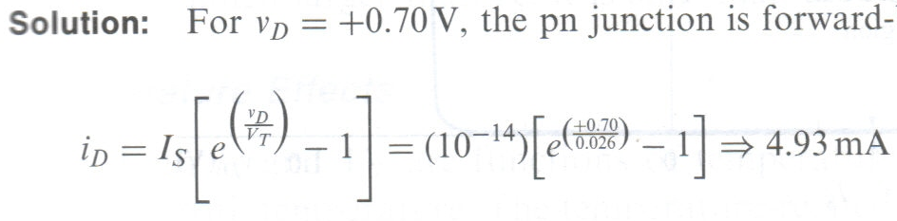
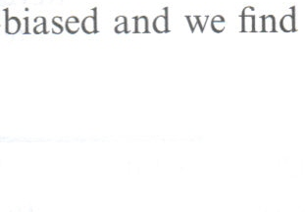


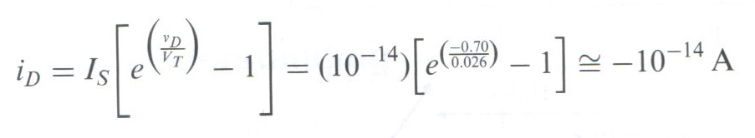
Ideal Current-Voltage Relationship
Example
Determine the current in a pn junction diode.
Consider a pn junction at T = 300 K in which I_{S} = 10⁻¹⁴ A and n = 1.
Find the diode current for v_{D} = +0.70 V and v_{D} = -0.70 V.
Very small current

Slide 32
Example 2
  A silicon pn junction diode at T=300K has a reverse biased current of I_{s} = 10⁻¹⁴ A. Determine the forward biased current for
  V_{D} = 0.5V
  V_{D} = 0.6V
  V_{D} = 0.7V

Slide 33
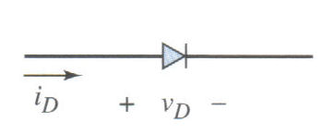
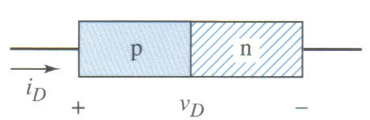
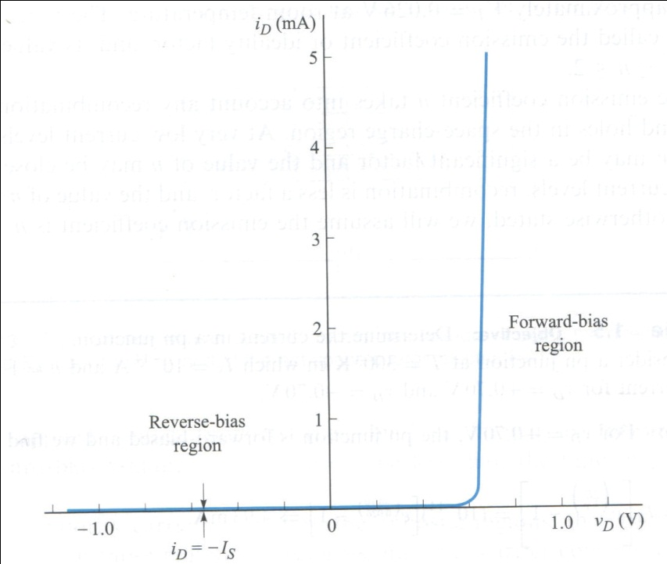
PN Junction Diode
The basic PN junction diode circuit symbol, and conventional current direction and voltage polarity.
The graphs shows the ideal I-V characteristics of a PN junction diode.
The diode current is an exponential function of diode voltage in the forward-bias region.
The current is very nearly zero in the reverse-bias region.

Slide 34
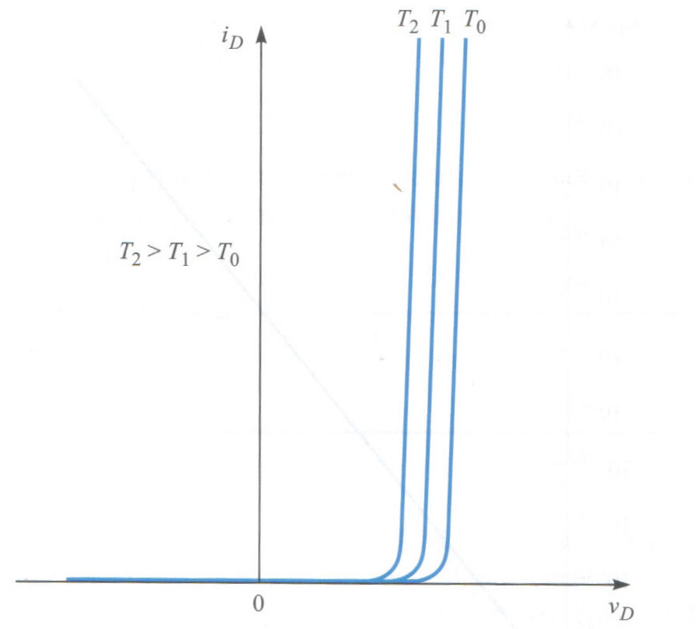
PN Junction Diode
Temperature Effects
  Both I_{S} and V_{T} are functions of temperature.
  The diode characteristics vary with temperature.
  For silicon diodes, the change is approximately 2 mV/ºC.
Forward-biased PN junction characteristics versus temperature.
The required diode voltage, V_{γ} to produce a given current decreases with an increase in temperature.

Slide 35
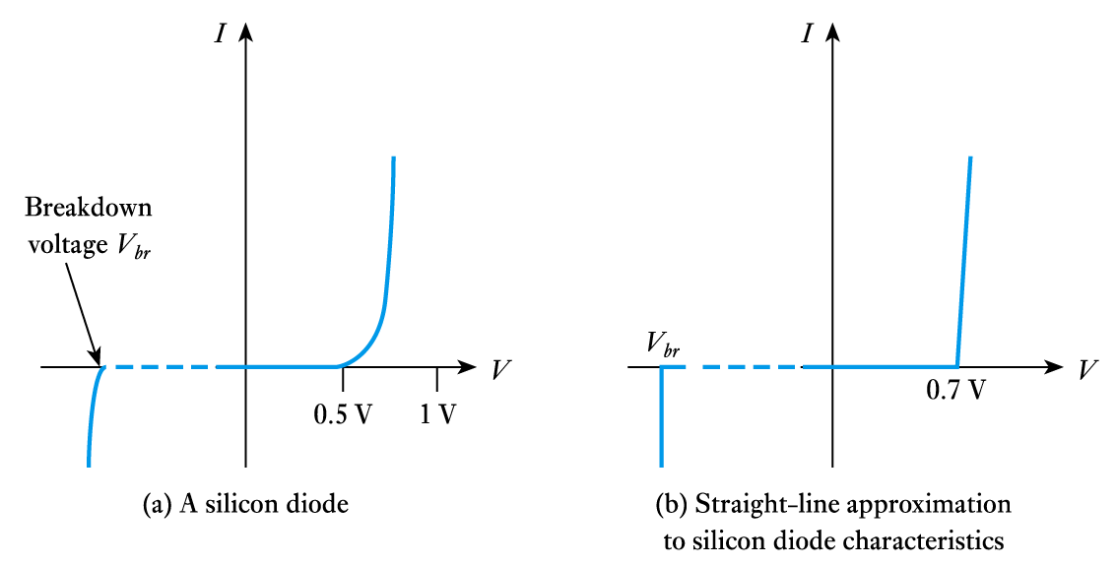
Turn-on and breakdown voltages for a silicon device

Slide 36
Conclusions
The characteristics in a pn diode are based upon excess minority carrier diffusion.
  Excess carrier concentrations are being formed by injection of carriers across the junction.
  The gradient of the excess minority carrier concentration at the junction determines the magnitude of the current.
  Delay times are due to the storage of excess minority charge in the layers.

